Slide 1
Issue Tree Template
STRUCTURED FOUNDATIONS
A Issue Tree is….
Sub-issue
Used as a tool to break a problem down into a series of hypotheses or issues that can be tested
Used as an approach to ensure all parts of the problem are considered. In other words, issues are collectively exhaustive.
Used as an approach to ensure issues do not overlap and are mutually exclusive.
Issue 1
Sub-issue
Sub-issue
Issue 2
Sub-issue
Sub-issue
Each Sub-Issue provides further level of detail for each issue, but is complete
and non-overlapping
Problem
Issue 3
Sub-issue
Issue 4
Sub-issue
Issue 5
Sub-issue
Complete but non-overlapping list of conceivable avenues to pursue
H
D
E
I
P

Slide 2
Values Tree Edition 1
What opportunities exist to reduce Monalco’s iron ore crusher’s break even costs from $50/ton to $40/ton
Decrease maintenance cost (damage needing to be fixed *price of fixing damage)
Do Nothing
Decrease Operation Cost
Reduce amount of damage done to crusher
Increase the amount of damage allowable on the machine
Reduce price per amount of damage
Reduce # of people needing to maintain the machine
Reduce salary of people maintaining the machine
Reduce amount of fuel being used
Reduce price of maintiaing fuel

Slide 3
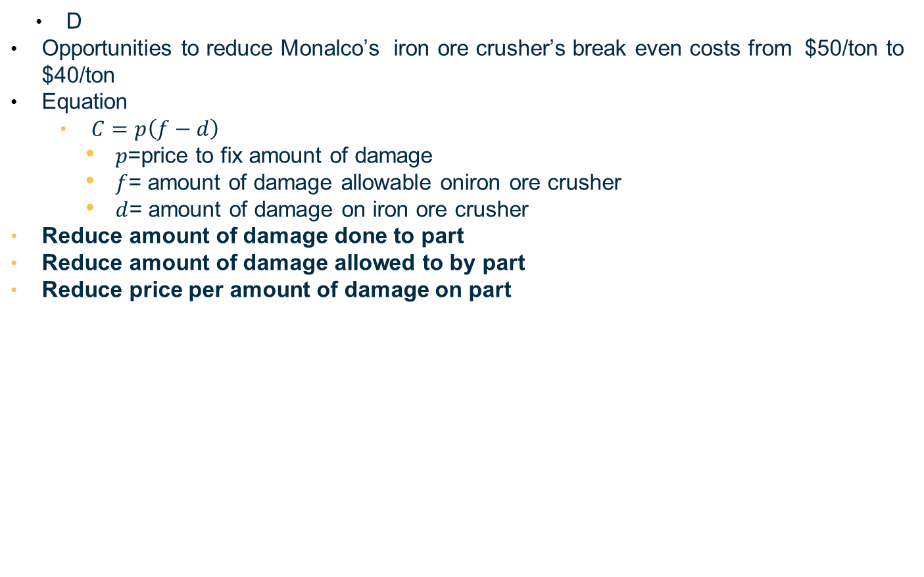
D
Opportunities to reduce Monalco’s iron ore crusher’s break even costs from $50/ton to $40/ton
Equation
$C=p\left(f−d\right)$
$p$=price to fix amount of damage
$f$= amount of damage allowable oniron ore crusher
$d$= amount of damage on iron ore crusher
Reduce amount of damage done to part
Reduce amount of damage allowed to by part
Reduce price per amount of damage on part

Slide 4
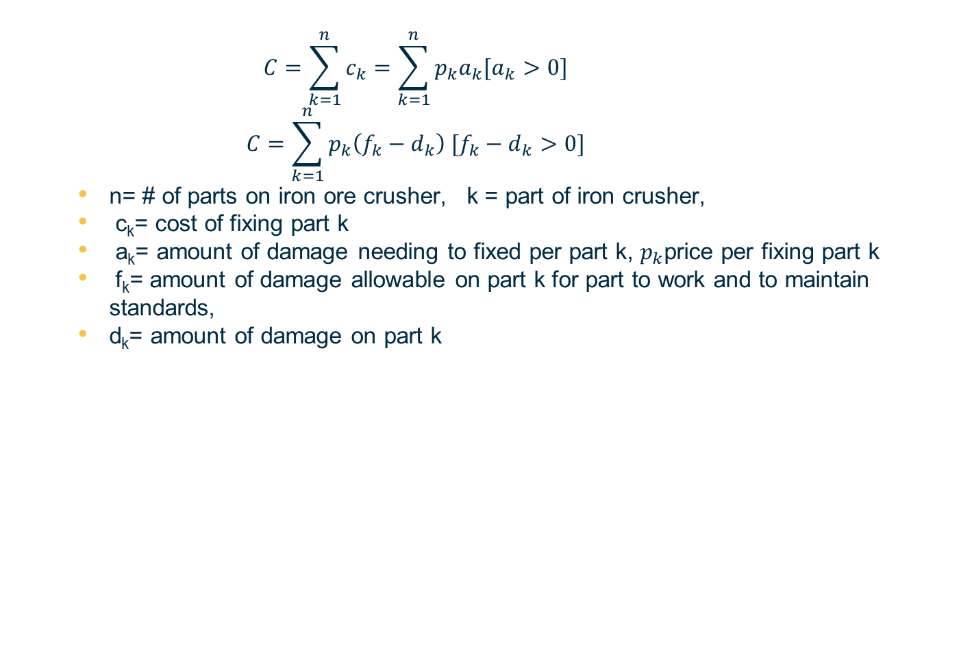
$$C=\sum_{k=1}^{n}{c_{k}}=\sum_{k=1}^{n}{p_{k}a_{k}[a_{k}>0]}$$
$$C=\sum_{k=1}^{n}{p_{k}\left(f_{k}−d_{k}\right) [f_{k}−d_{k}>0]}$$
n= # of parts on iron ore crusher, k = part of iron crusher,
c_{k}= cost of fixing part k
a_{k}= amount of damage needing to fixed per part k, $p_{k}$price per fixing part k
f_{k}= amount of damage allowable on part k for part to work and to maintain standards,
d_{k}= amount of damage on part k

Slide 5
Values Tree Edition 2
short term opportunities for Big Mountain Resort to recoup the additional operating cost
Increase Revenue by changing the Price
Decrease Expenditure
Buy Less
Pay less for the same quantity of goods
Do Nothing
Optimize Weekend Price
Optimize Weekday Price
Optimize Weekend and Weekday Price

